Slide 1







AUDIO
BOOKS

Slide 2





Categories Section
MECHANICS SECTION
UPLOAD YOUR DOCUMENT AND MAKE IT AUDIBLE...
1
ABSTRACT
2
PROBLEM STATEMENT
3
PROBLEM DESCRIPTION

Slide 3
Categories Section
MECHANICS SECTION
UPLOAD YOUR DOCUMENT AND MAKE IT AUDIBLE...
4
WHICH MODEL IS SELECTED?
5
WHY THIS MODEL?

Slide 4


ABSTRACT

Slide 5


ABSTRACT
Audio Books are not new to our world.
Many people are using audiobooks to enhance their life to be productive, as they were busy in daily life.
So, audiobooks also play some important role in our day-to-day life.

Slide 6


PROBLEM STATEMENT

Slide 7
PROBLEM STATEMENT
There are many apps and websites, where we can BUY audiobooks. But, we need to pay money for all those apps and websites.
Audiobooks can be more expensive than hard copy or eBook.
Most of the people wants to be productive by reading or hearing book. But they can't afford it.

Slide 8


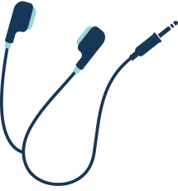
PROBLEM DESCRIPTION

Slide 9
PROBLEM DESCRIPTION
As there are many websites and apps, they were too expensive to afford as a middle class person. Books cannot be streamed, so downloading to your mobile device will use up storage.

Slide 10
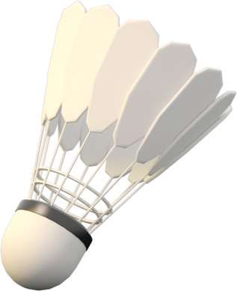




WHY OUR PRODUCT???
FREE
STORAGE
USER FRIENDLY
Free storage for first 100 books. You can download and listen offline
Our website is user friendly, So that anyone can use
Free of cost. You just need to sign in to our page

